Slide 1

Predicting Credit Card Debt Relief
Machine Learning for Economics
Matt Amor
Alan Samuel
Adriana Soto
Daniel Temprano

Slide 2

Research Question & Data
Predicting whether relief is given for credit card debt collection complaints filed in the U.S. with the CFPB
Using Consumer Financial Protection Bureau (CFPB) data on relief granted for credit card debt
Checking for ethical considerations in model prediction for age 65+ populations

Slide 3
Data Discussion
Missing Data
ZIP codes:
11.6% missing/incomplete
Imputed using K-nearest neighbor
Compared with random forest imputation on three metrics of accuracy
Measures of debt:
Median imputation over 5 years for insecurity measures
Student, auto, and medical debt were snapshots
Unsystematic missing values
Random forest imputation

Slide 4
Data Discussion
Final dataset: 61,656 observations, 37 predictors
Economic variables:
Local financial stress: Percent uninsured in area (SAHIE)
Housing: Housing permit application count (Census)
Cost of living: Fair Market Rent (HUD)
Education: Percentage of 25+ population with a bachelors or higher degree (Census)
ZIP/FIPS removal due to:
Computational efficiency concerns
Geographic variable ended up being State
Other variables (ie proportion female, proportion black, etc) explains the model meaningfully without ZIP/FIPS
Principal components: based on debt metrics – 4 PC’s explain 75% of variance
Interactions: demographic variables
Clusters
Notes:
PC with debt metrics and ended up with 4 components that explains 75% of the variance.
Cluster analysis: used one of the PC, share of people of color, prop 65+, year, issue, and prop_young

Slide 5

01
Model Selection

Slide 6
Priorities
Accuracy
Final Model should be more than 73% baseline
Focusing on false negatives
Mitigating Future Bias
We want to avoid adding bias in future iterations
Ethical Considerations
Lesser considerations:
Interpretability
Computational efficiency
Notes:
Explaining why interpretability is a lesser consideration: bc company and issue were largely influencing predictions across the models, we could surmise that this is influential already so interpretability is less of a concern

Slide 7
Model Selection: Winners and Losers
 | CATboost | Xgboost | OLS | Logit | Random Forest | Lasso | CART | Neural Net
Accuracy | 80.55% | 80.54% | 78.3% | 78.8% | 79.6% | 78.62% | 79.18% | 73.76%
F1 | 0.549 | 0.551 | 0.509 | 0.531 | 0.454 | 0.476 | 0.507 | 0.843
False Pos. | 6.4% | 6.5% | 5.9% | 6.9% | 2.5% | 6.38% | 7.05% | 49.37%
False Neg. | 55.4% | 55.2% | 65.1% | 62.8% | 70.4% | 63.19% | 59.2% | 25.69%
Notes:
Accuracy recall precision and F1
AIC for Logit = 53617
AIC for OLS = 56682

Slide 8
Final Model: CatBoost
Model Metrics:
Loss function: logloss
Hyperparameters:
depth: 2/4/6
Run time: 2 hours (compared to 12 for XGboost)
Learning rate: 0.05/0.1/0.3
Balanced accuracy: 69.1%
Dataset was imbalanced (more rejections than acceptances of relief)
Subset sample percentage correctly predicted relief:
Results:
Catboost performed marginally better than XGboost
Comparable false negative rate to XGboost, and better than other models
More computationally efficient than XGboost on categorical data
Most important variables: company, issue,
Notes:
The class imbalance in the data could be because we combined all the different relief outcomes that weren’t “received relief” into “didn’t receive relief”
Due to optimizing for accuracy, false negative ratio was quite high, could optimize in the future for f1 score or AUC as the selection criteria instead
162 combinations of parameters were chosen for the Catboost and if we chose f1 score or AIC as selection criteria the false negative score would likely not have been so high.

Slide 9
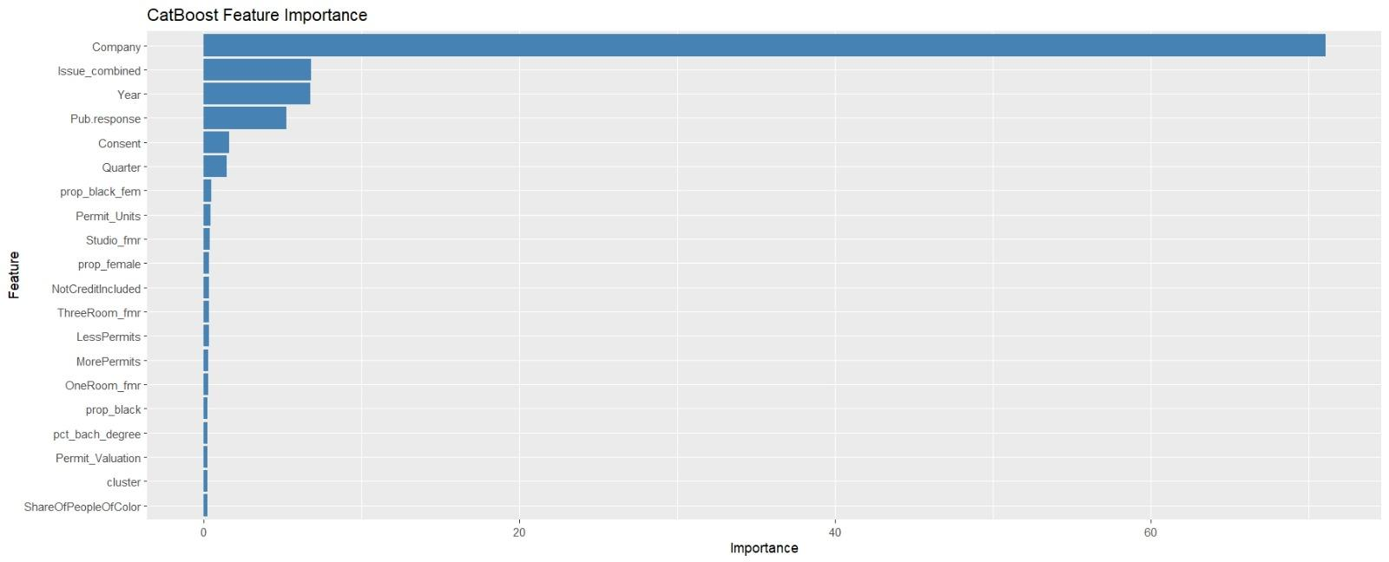
Model Interpretation
Across the models, credit bureaus are more likely to grant relief than banks
(TransUnion, Experian, and Equifax)
Notes:
What seems to be going on is that certain companies are more likely to grant relief

Slide 10
Models not chosen
OLS, Logit, Random Forest, Lasso, CART, Neural Net.
All models had a higher false negative rate than the CatBoost model chosen.
 | OLS | Logit | Random Forest | Lasso | CART | Neural Net
Reason: | OLS was least accurate and the relationship clearly wasn’t linear. | Logit was not chosen as it did not perform better in accuracy at 78.8%. | RF was not chosen as it did not perform better in accuracy at 78.13%. | LASSO was not chosen as it did not perform better in accuracy at 78.16%. | CART was easily interpretable with an accuracy of 78.89% | Neural Net did not converge and did not yield an accurate or interpretable model.
Notes:
XGBoost and catboost were nearly identical but catboost ran much faster, neural net did not converge and would always predict 0 (not learning anything). Neural net was run on only 20 variables vs xgboost/catboost run on all 37.

Slide 11
02
Test Data

Slide 12
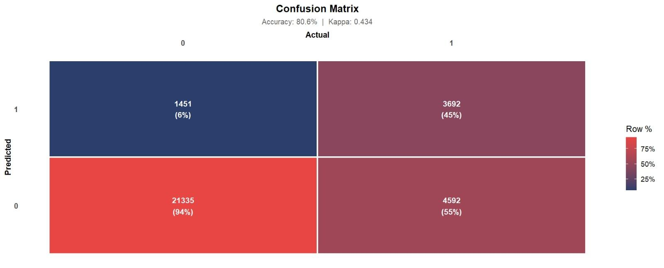
Test Data Confusion Matrix
CatBoost leaned towards predicting no relief
Notes:
Top left is false positive, bottom right is false negative

Slide 13
Cost of Living
Fair Market Rent
We tested for the change in predicted probability of relief in the 25th and 75th percentiles
Holding other variables constant, in both groups the predicted relief was identical at 21.4%
Given the outsized importance of other variables, this result is not surprising

Slide 14
Ethical Considerations
Model bias and ethical considerations of demographic variables:
Proportion of Population aged 65+
The model was biased towards not granting relief to seniors
Threshold for being considered an older county is 62% (CFPB)
69.5% false negative (as compared to 55.2% full)
Proportion Black Population:
Pew national average black population (2023): 14.4%
62.3% false negative rate: (as compared to 55.2% full)
Wanted to minimize false negatives, so we don’t introduce bias into later iterations of the model
Fairness considerations

Slide 15
Recommendation:
We would NOT recommend this model.
While it performed the best among our models, it is more biased against certain demographics (age 65+, black) than the overall population
Future work would include more interactions for demographic variables and Company and Issue
Retraining the model, we would optimize for recall at the expense of overall accuracy

Slide 16
Final Model Score:
 | CATboost
Accuracy | 80.5%
F1 | 0.606
False Pos. | 6.5%
False Neg. | 55.2%

Slide 17
Questions?

Slide 18
Appendix

Slide 19
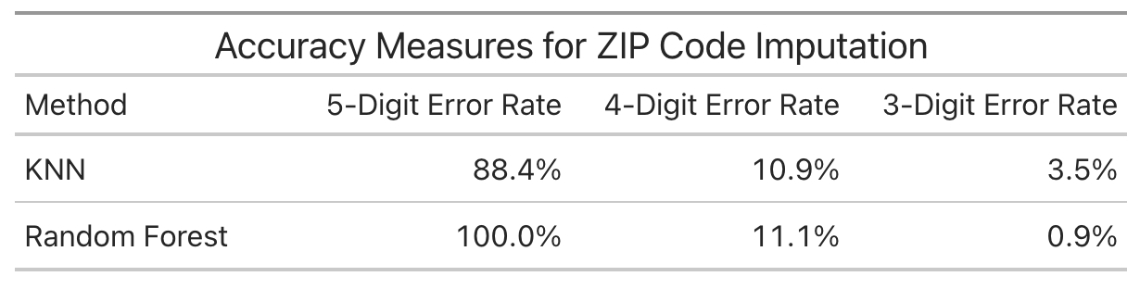
Zip Code Imputation
We selected K-nearest neighbor imputation because it performed better on the missing digits
We used a subset of known zip codes and ran KNN and RF imputation on masked values
Error rates are based how well the imputed zip codes match actual values on the first X digits
We forced the final 3.5% of mismatched imputed values to the nearest valid zip code sharing the 3-digit prefix of the given zip.
After imputation, 12 observations did not match their given State or zip prefix.
One zip code straddles KY and TN
The rest of the mismatched zips were not valid zip codes in our lookup.

Slide 20
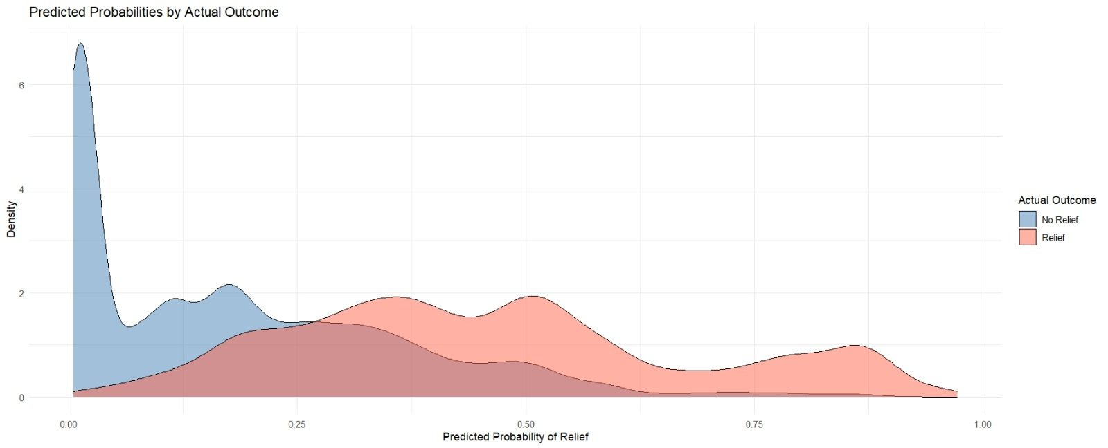
Predicted Probabilities by Actual Outcome

Slide 21
Model Overview: Winners and Losers
 | CATboost | Xgboost | OLS | Logit | Random Forest | Lasso | CART | Neural Net
Accuracy | 80.55% | 80.54% | 78.3% | 78.8% | 79.6% | 78.2% | 79% | 73.76%
F1 | 0.549 | 0.551 | 0.509 | 0.531 | 0.454 | 0.531 | 0.565 | 0.843
False Pos. | 6.4% | 6.5% | 5.9% | 6.9% | 2.5% | 6.9% | 7.1% | 49.37%
False Neg. | 55.4% | 55.2% | 65.1% | 62.8% | 70.4% | 62.8% | 59.4% | 25.69%
Notes:
Accuracy recall precision and F1
AIC for Logit = 53617
AIC for OLS = 56682

Slide 22
Data dictionary
Relief - Company response of Debt Relief (Binary 0/1)
Year - factor
State - Geographic variable
Pub.response - Company’s Public Response
Consent - Complainant consent of narrative given
Submitted.via - Means of submissions such as Web, phone, postal mail etc
Timely - Whether company responds within 15 days
Month, Quarter - factors
LessPermits, MorePermits - whether a county had high or low levels of housing building permits
ShareOfPeopleOfColor - proportion of county made up of people of color
CI_score - Score based on Credit Insecurity Index (CII) by the New York Fed
NotCreditIncluded - proportion of county with no credit history
CreditConstrained - proportion of county who are credit constrained
CreditTier - Numbered factors 1-5, indicating county-level credit security

Slide 23
Data dictionary
Studio_fmr, OneRoom_fmr, TwoRoom_fmr, ThreeRoom_fmr, FourRoom_fmr -
Fair market rent for various units
Permit_Units, Permit_Valuation - Housing permits issued
PCTUI_PT - percentage uninsured in specified geographic area from SAHIE
pct_bach_degree - percentage of the population that are 25+ with a bachelors degree or higher
is_servicemember
is_older_american
prop_young, prop_65plus - Proportion of people under 25, and older than 65
Prop_female, prop_hispanic, prop_black, prop_black_fem - proportion of respective demographic variables
is_older_county - 1 if county has higher than average proportion of people older than 65, 0 otherwise.
cluster - cluster made up of PC1, Year, Issue, Share of people of color, prop_young, prop_65plus
Company - company name
Issue_combined - variable combining customer issue and sub-issue

